Slide 1
Training Course on Ecosystem Based Climate Change Adaptation
The Integration of Ecosystems into Infrastructure for Climate Change Adaptation
(Module 3)
Lead developer: John Matthews, World Wildlife Fund
Co-developers: Eliot Levine, World Wildlife Fund
Nikolai Sindorf, World Wildlife Fund
Bart Wickel, World Wildlife Fund
Henk van Schaik, Cooperative Programme on Water & Climate
Notes:
-Definition of infrastructure?
Infrastructure traditionally refers to human “built structures” which require expensive planning and development.
These, often very large, structures, while providing many services, they may not always be as sustainable as they used to.
The goal of this session:
Provide an understanding of the issues aroudn planning and operating infrastructure that sustainably integrates ecosystems ina shifting climate.

Slide 2
Adaptation principles from module one
Avoid Degradation
Restore Lost Services
Integrate Ecosystems into Planning
“Adaptation Interventions need to contribute to a win-win solution to climate change as well as to other conservation and development challenges”
“Uncertainty needs to be considered in planning”
Adaptation Principles

Slide 3
In this presentation….
The goal of this presentation is to provide an introduction to some of the principles and challenges around planning and implementing adaptation interventions that sustainably integrate ecosystems and communities in a shifting climate.
Adaptation Principles
How climate shapes our relationship with the planet
Infrastructure as a mechanism for adaptation
Institutions as adaptation implementers
Working with multiple future scenarios

Slide 4
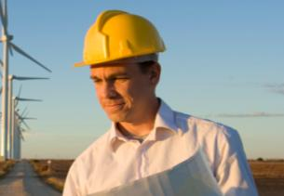
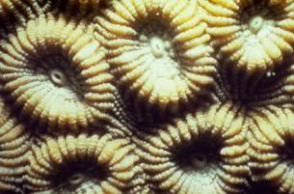
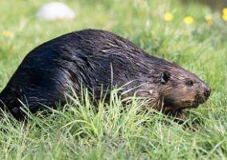
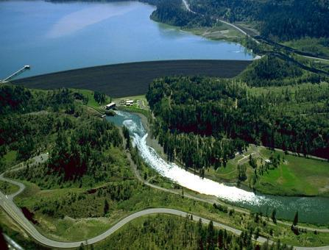
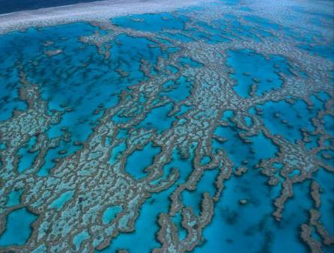
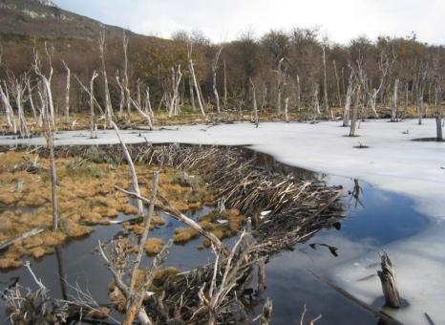
Our built world: Ecosystem Engineers
Ecosystem Engineers:
Intended and unintended consequences
Notes:
Lets step back though:
If we are to go off the definition that infrastructure is our built and engineered world than we should consider the other types of engineers that we share the planet with.
Humans: of course design and build massive structures that dramatically alter the environment for a suite of purposes.
Coral: The tiny animals form coral profoundly alter the surrounding waters as well by creating a magnet for other species, and making them biodivesity hotspots in the ocean.
By “engineering” a massive calcium carbonate structure, corals alter regional ocean currents, ocean chemistry, temperature patterns, and other aspects of marine environments. They even provde shelter from tsunamies for human communities on shore.
Beavers: in the Northern Hemisphere Beavers do something similar. They find a small stream, build a dam out of woody plants and creating a pond or small lake that profoundly alters the surrounding forest and streams.
- Just like the corals and humans however these built structures have unintended consequences.
- Shifts in the mix of fish and aquatic insects species occure when the pond deepens
Humans, Coral, and Beavers: we purposefully alter our environment to suit our needs. However humans are definitly the ultimate ecosystem engineers.

Slide 5
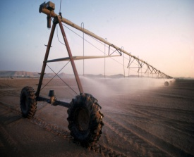
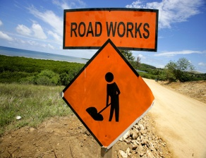
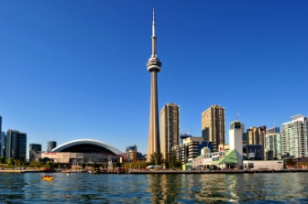
The Ultimate Ecosystem Engineer
Changing climatic conditions will significantly alter the way we interact with the environment
Adaptation is largely about changing the way we interact with, manage, and think about different aspects of, and services provided by, the environment
Much of our interaction with the environment is through infrastructure and the institutions that manage it.

Slide 6
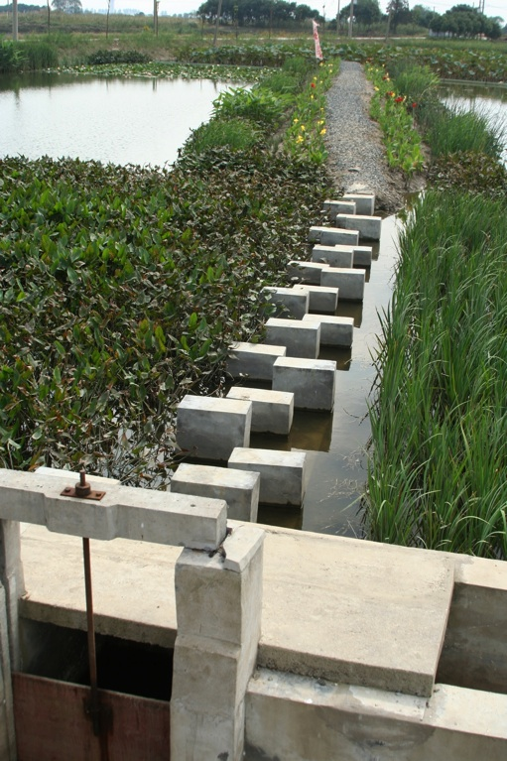
Ecological Integrity, Sustainable Development, and Infrastructure
Large scale infrastructure in Western, developed counties has slowed, but will not stop.
Infrastructure development in emerging economies is now growing very quickly.
As such, we need to design, build, and operate infrastructure that has a reduced footprint, and takes into account variable climatic conditions.
Notes:
Large scale, hard, infrustructure is developing at an extremely fast rate in untraditional countries
Some of more highly developed, Western, countires may have slowed, but it has not stopped, and much infrastructure is in bad need of replacing.
As such it is imperitive that our design, build, and operation of infrastructure needs to have a small footprint that takes into account variable climate conditions.

Slide 7
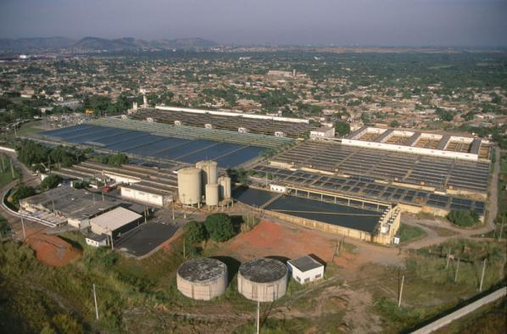
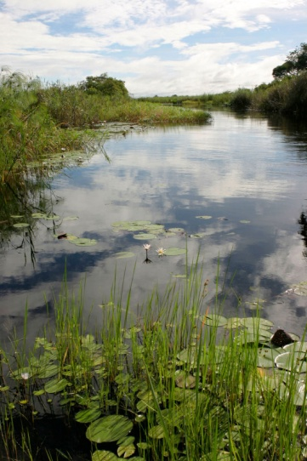
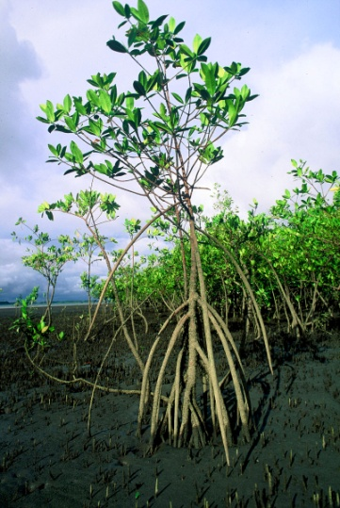
Infrastructure
Hard Infrastructure: aspects of the ecosystem that are purposefully engineered through permanent changes.
Soft Infrastructure: explicit use of ecosystem (or aspects of them), and their processes in order to fulfill some human need.
Notes:
Hard infrastructure: Dams, roads, airports, buildings, etc…
Soft Infrastructure: The use of mangrove forests as a shield fro coastal human populations from vilent storms, cyclones, and tsunamis. (Discussed more later)
Social institutional: The software that runs the hardware. We are responsible for the operation, maintenance, and performance of our built structures.

Slide 8
How does Climate Change alter how we think about infrastructure?
Climate change presents a major challenge to all types of infrastructure.
Climate conditions will become increasingly variable rendering infrastructure more vulnerable.
We need to consider:
  How existing infrastructure is managed and/or altered
  How new infrastructure should be planned and operated. Or how can infrastructure be used to help us adapt.
Climate largely decides how we structure our lives
Agriculture
Crop varieties
Water availability
Cities
Drinking water
Spread of disease
Extreme, disruptive, events
Energy
Industry
Food security
Notes:
Imagine a farmers field. Climate plays a huge role in:
Crop that can be grown, the water available for those crops, likelyhood of extreme events
Now thinks about Paris, Dubai, or Shanghai. Over 50% of the global population lives in urban areas.
Since climate plays a huge role in the way a city functions through drinking water, energy production, food availability, spread of disease. All of these items are climate sensitive.
So climate actually plays a big role in how we humans structure our lives, wherever we live. And that means that our infrastructure plays a big role in how we address climate.
However agriculture as well as drinking water, energy production, and food availability rely significantly on infrastructure which was designed, built, and has been operating under the assumption relative stability.
However, climate conditions growing more variable.
This means we need to recognize that our planning and decision making processes when it comes to infrastructure are much more complex than ever before.

Slide 9
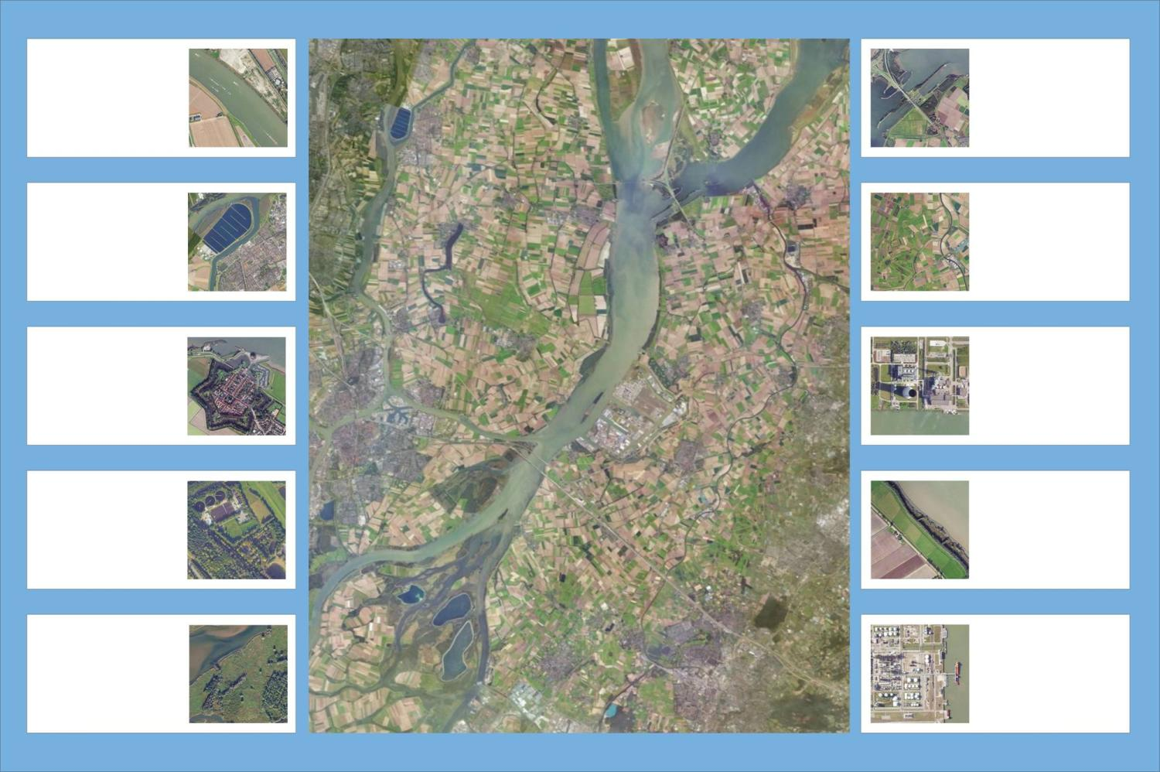
Hydrological services from infrastructure
Navigation
Infrastructure
Water levels
Canals, locks
Dredging, banks
Docks
Storage
Distribution
Allocation
Conveyance
Household
Agriculture
Drinking
Sanitation
Gardening
Carwash
Irrigation
Groundwater
Sedimentation
Livestock, aq. cult.
Societal
Electricity
Tourism
Sports (golf?)
Aesthetics
National security
Steam
Cooling
Hydropower
Safety (nuclear)
Drainage / waste
Flood control
Conveyance
Resilience
Concentrations
Connectivity
Seasonal floods
Security
Floodplains
Droughts
Nature
Industry
Conservation
Natural resources
Climate change
Eco-processes
Ingredient
Processing
Wastewater
Google Earth Imagery 2007
Notes:
Because infrastructure is weaved so tightly into almost all aspects of our lives, it can often be difficult to recognize all the services we rely on them for:

Slide 10
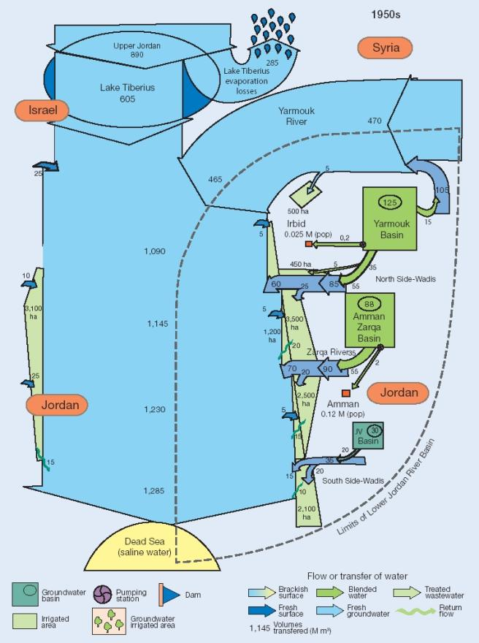
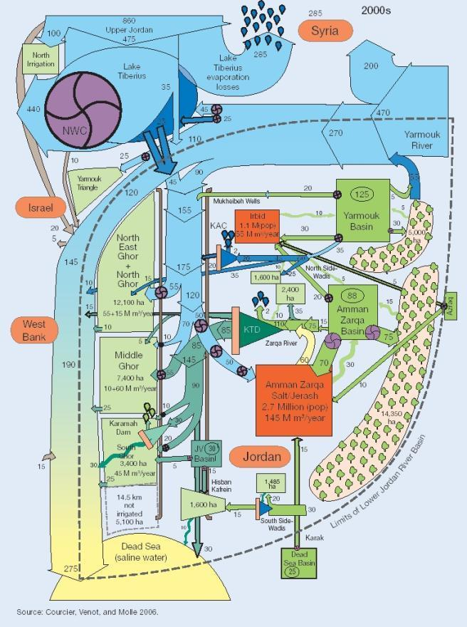
A system with a high intensity of water infrastructure taps more ecosystem services
Source: Water for Food, Water for Life, 2007
Notes:
This dependency on infrastructure makes sense, right? Infrastructure helps us tap into and use more ecosystem services.

Slide 11
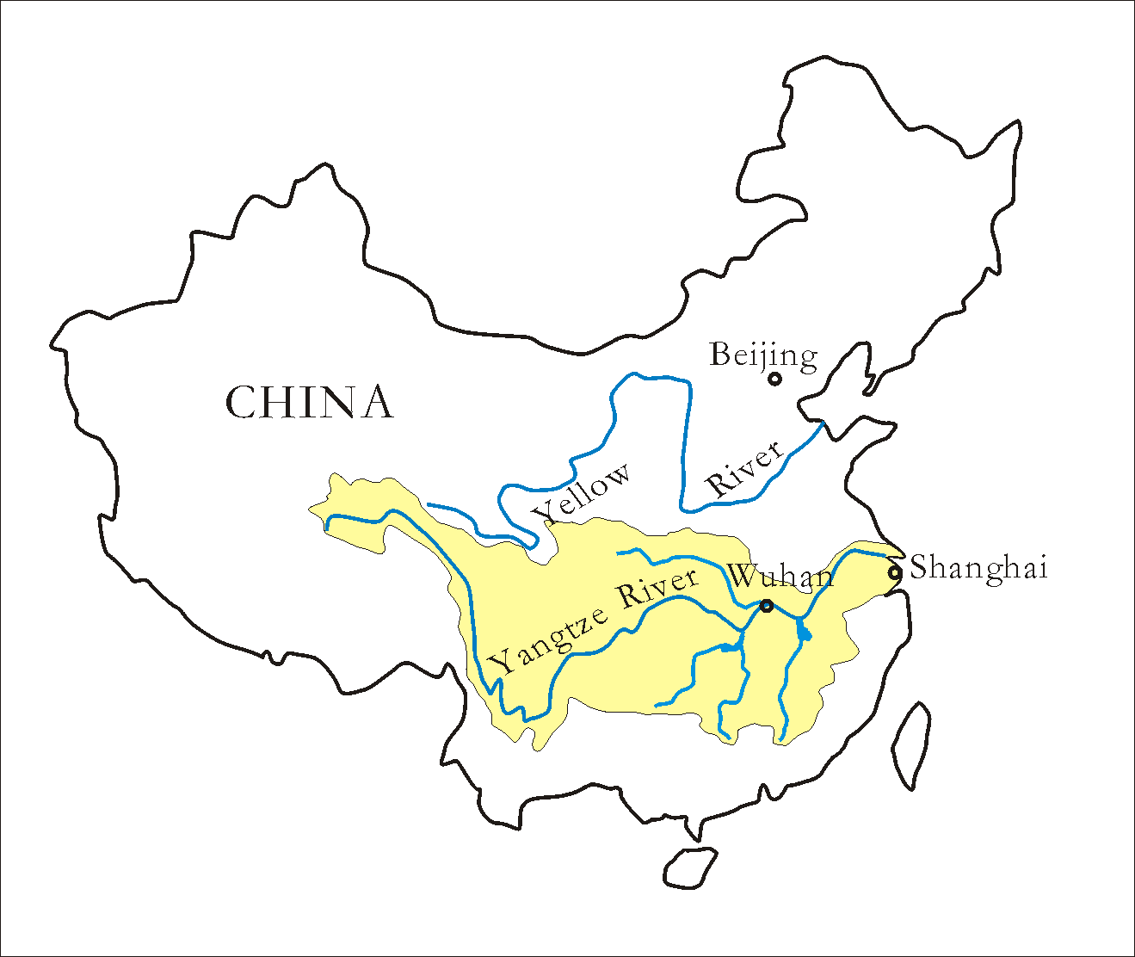
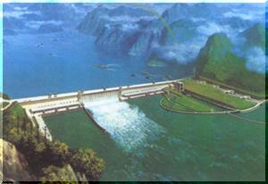
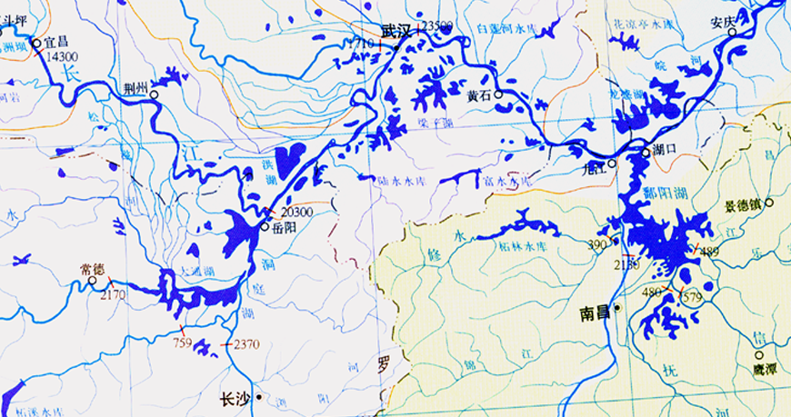
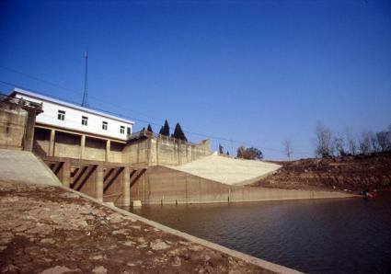
Case Study: Restoration of Riparian Wetlands
1950: Chinese engineers channelize the mainstem of a section of the Yangtze river.
  Separated from networks of lakes and wetlands
  Wetlands drained and converted to farmland.
  Wetlands used for aquaculture programs
1970 -1980’s:
  large portions of wetlands are lost.
  Massive flooding risk increases downstream
  Agricultural productivity dropped
  Water quality worsened
  Species started to decline
Presently:
government is reconnecting the river to the system of wetlands and lakes.
Wetlands once again providing flood protection services
Avoid Degradation
Restore Lost Services
Integrate Ecosystems into Planning
Notes:
Recently: WWF China is working with government to reconnect the river to the system of wetlands and lakes.
Open up the sluice gates that were managing the flow to re-establish the natural flow of water.
Now: Wetlands that were once almost lost have been acting as overflow basins and holding large volumes of water during recent heavy rain events. In more recent years this water would have flooded the downstream communities.

Slide 12
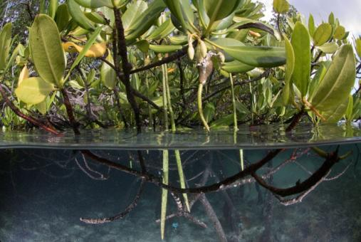
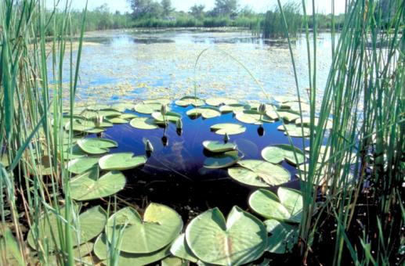
Soft Infrastructure Case Study: Bioshields for Coastal Defense
“Bioshields”
Coastal forests and wetlands.
Popular as coastal defense mechanism use in protecting against tropical cyclone storm surges, tsunamis, and sea-level rise
Touted as examples of integrated hard and soft infrastructure

Slide 13
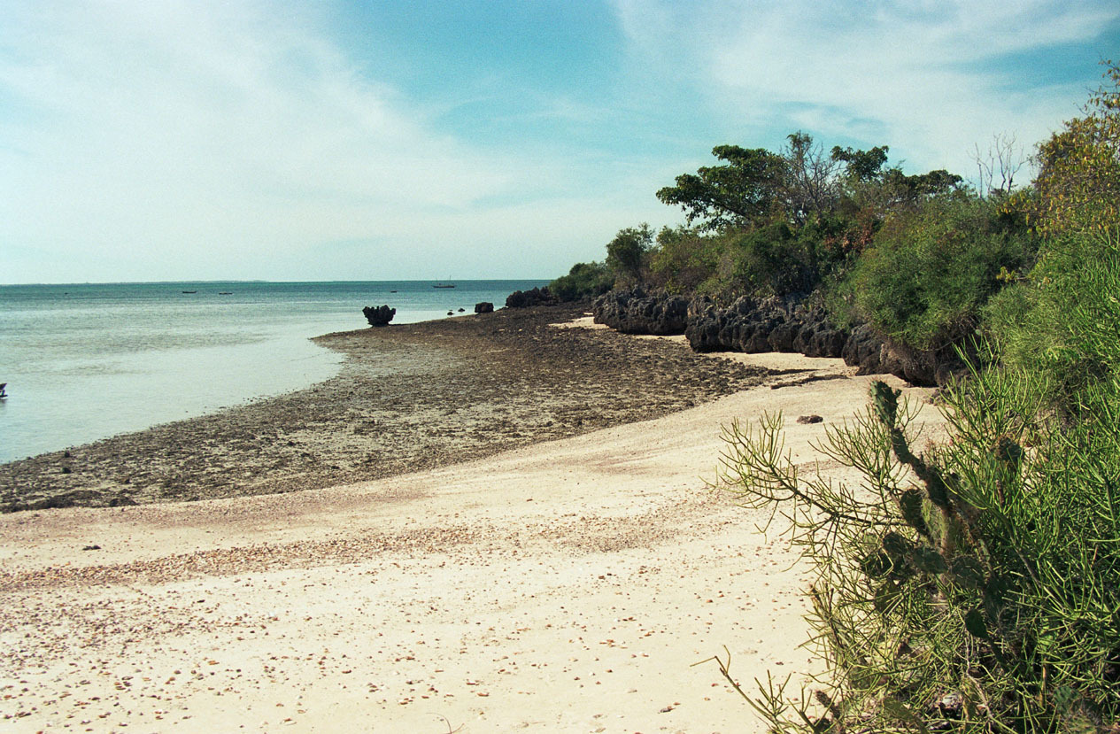
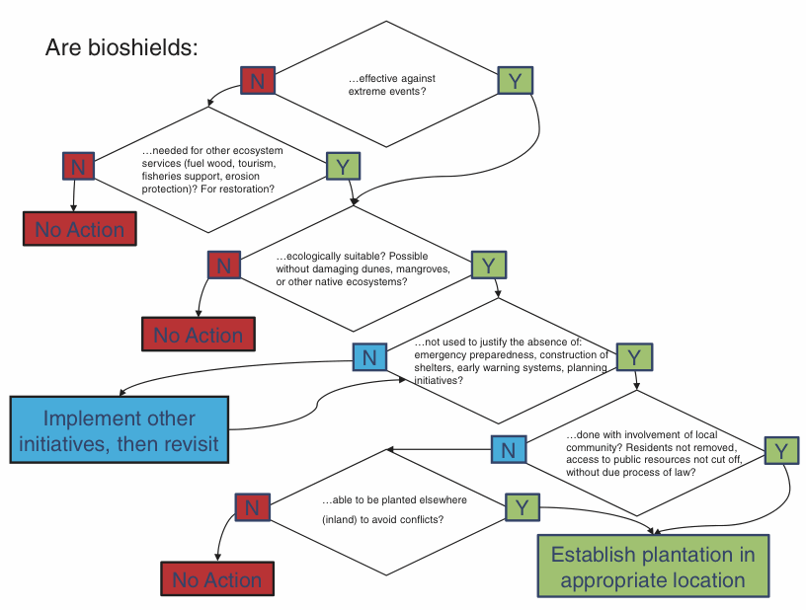
Soft Infrastructure Case Study: Bioshields for Coastal Defense
Feagin et al. on Bioshields
An evidence-based approach for coastal bioshields seems warranted.
Evidence for the efficacy of bioshields is very weak for extreme events.
The promotion of new bioshields has come at the expense of native ecosystems.
Coastal ecosystems should be valued most heavily for a wide range of ecosystem services they provide

Slide 14
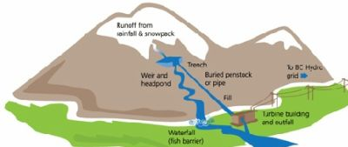
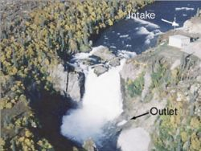
Hybrid Infrastructure : Niagara falls and power generation
Leaves the river intact
Amount of power is dependent on amount of water diverted through the turbine
Flexibility in the flow divert to the turbines
No impact on fish migration
Low economic investment
Hybrid engineering, or mixed hard and soft infrastructure, is the integration of ecosystems into designed infrastructure development and operation
Notes:
Run of river hydroelectric projects operate without dams or other obstructions to the flow of the river. For this reason they are less disruptive to the natural state of a river.
Some systems may have a small pond or partial dam at the inlet, but strictly speaking a run-or-river leaves the river intact.
The systems don’t interfere with navigation or fish migration. Water levels or the river change as they normally would. There is minimal disruption of the land surrounding the river.
Because there’s no huge investment in building a dam to recover, smaller run of river systems often make economic sense.

Slide 15
From a Climate Adaptation Standpoint:
Infrastructure should be:
Robust to multiple climate Futures
Resilient to extreme events
Decisions must consider:
Multiple time scales
Economic, social and environmental perspectives
Infrastructure technology needs to be :
Appropriate to the social and economic systems
Adjustable to change
Avoid degradation
Integrate ecosystems

Slide 16
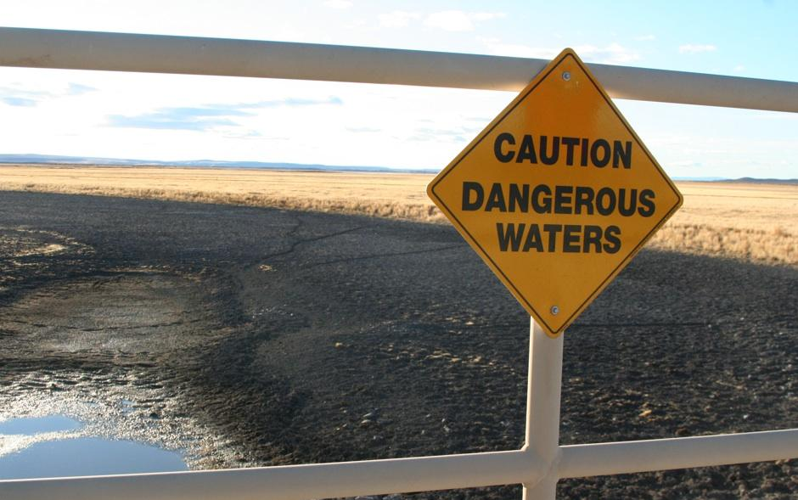
Adaptive Institutions
What are Institutions?
The organizations, natural resource management authorities, and governments that manage resources, enforce policy, and protect public goods and services.
Primarily the “stuff” of the social realm that greatly impact our relationship with the natural world.
Examples: municipalities, government agencies, water management authorities.
All aspects of our relationship with and use of the environment must become more flexible to accommodate change.
Institutions must be able to:
  Detect change
  Adjust to accommodate those changes
  Learn from mistakes
Notes:
Institutions are the entities that manage infrastructure.

Slide 17
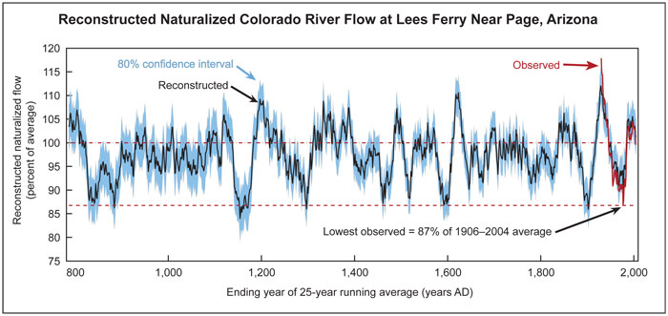
Snap Shot: What happens when we get it wrong?
1922: Colorado River Compact signed
  serves as the basis for water allocations for roughly 80 years.
    Las Vegas and Los Angeles grew extensively
    Some of the largest dams in human history were built
Today: the regional climate is drying up.
How did we get it wrong?
We Assumed:
    Fixed climatic conditions
    Incomplete observations/data
Dave Meko, Laboratory of Tree-Ring Research, University of Arizona.
Notes:
Reconstructed naturalized colorado river flow at lees ferry near page, arizona

Slide 18
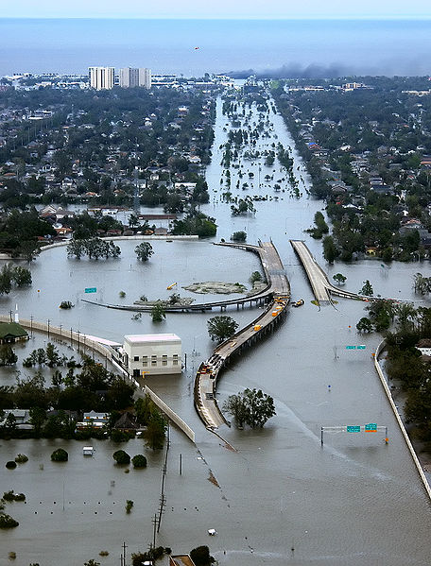
What does a non adaptive institution look like ?
New Orleans, USA:
Policy makers knew the city was not prepared for such an event the size of Hurricane Katrina a year prior.
Major Development in floodplain regions that were not adequately protected by levees
What flood protection did exist was inadequate and/or poorly maintained.
The city was incapable of effectively adjusting their actions in order to preemptively prepare

Slide 19
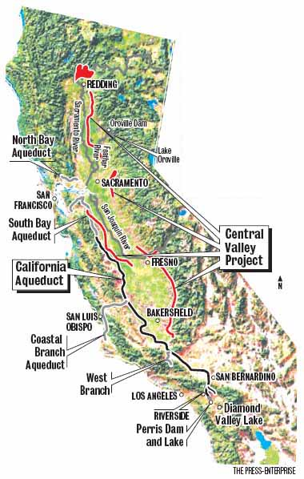
What does and adaptive institution look like?
Water Banks
A system where stored water is transferred from water rich are as to water deficient areas
California experienced a long period of droughts in the late 80s and early 90
In 1992 the sate government set up and managed Drought Emergency Water Banks to facilitate the allocation of water.
Transfer water from low-valued uses to high-valued uses during a period of intense scarcity.
Buyers and sellers made an early deposit on the water they thought would need or would be able to supply. Allowing the Bank to anticipate supply and demand more accurately.
Lessons:
Systems can be established to make us of ALL the water in a particular system.
Efforts to predict usage based on past experience will help prepare institutions to manage resources more efficiently
Versions of this system can work elsewhere
Notes:
l Niño-Southern Oscillation, or ENSO, is a climate pattern that occurs across the tropical Pacific Ocean on average every five years.
Developing countries dependent upon agriculture and fishing, particularly those bordering the Pacific Ocean, are the most affected.
In Africa, East Africa, including Kenya, Tanzania and the White Nile basin experiences, in the long rains from March to May, wetter than normal conditions.

Slide 20
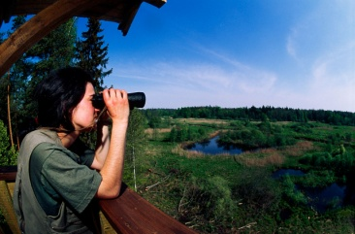
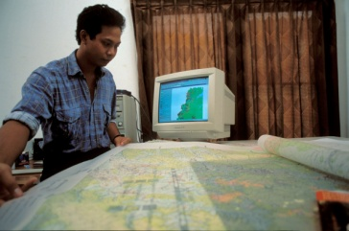
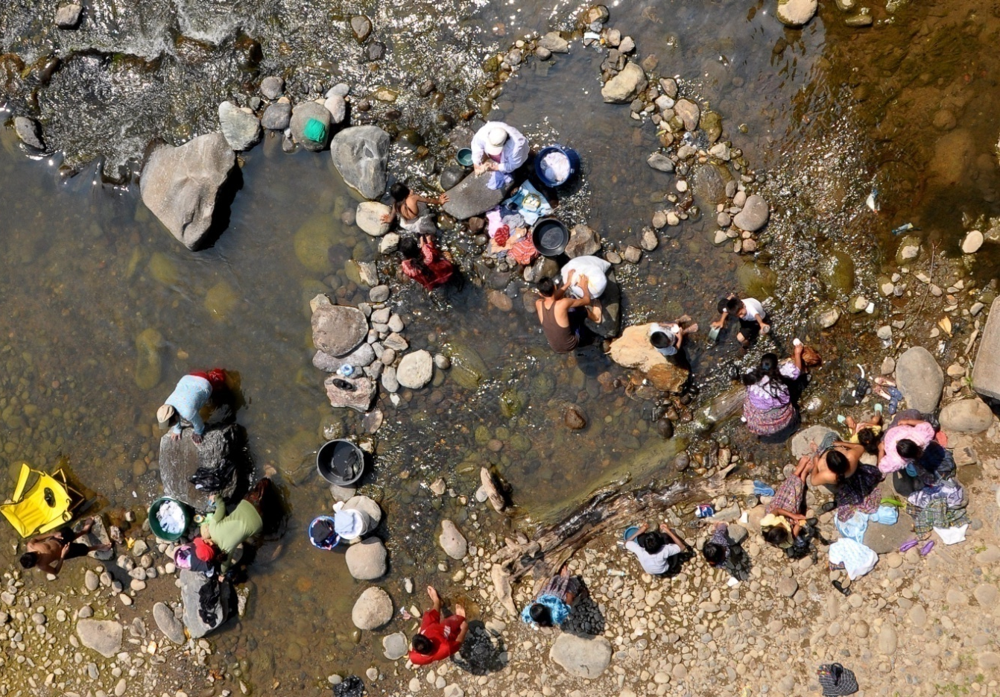
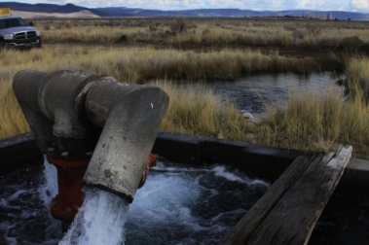
Principles for institutional management of water in a changing climate
Become better predictors of changing allocation of water rights
Monitor and evaluate consumption over time.
  Define critical thresholds for each sector.
Better integrate groundwater and surface water rights
Plan a system allocating water to “priority users” in times of need.
Define clearly who is responsible for protection and restoration of environmental services and values.
Create and preserve a water supply safety margin
Plan for adaptation

Slide 21
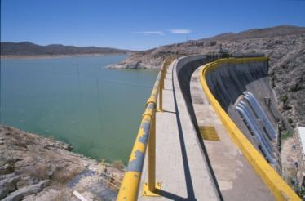
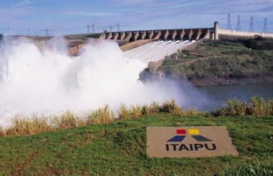
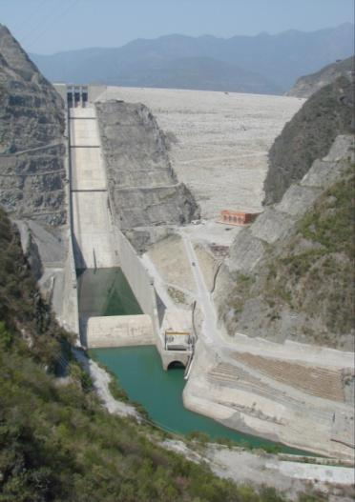
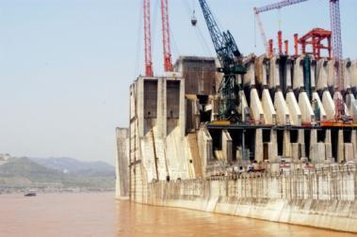
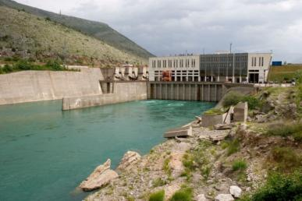
Water and Climate Change: What makes water so special?
Mexico
Brazil
Water has been the object of human infrastructure for millennia.
“Water is the medium through which humans will experience ... most climate change impacts” -IPCC, 4th Assessment Report, 2007
We must address the design and operation of human infrastructure.
India
China
Bosnia

Slide 22
Water and Climate Change: Increasing Stress
Climate??
Water
Domestic
Energy
Agriculture
Industry
Freshwater
Ecosystems
Water Stress
Domestic
Agriculture
Industry
Energy
Freshwater
Ecosystems
Ideally all environmental flow conditions are met
Under changing climate conditions both permanent shifts, as well as episodic unexpected shortages can be expected.

Slide 23
Activity: Water Usage, Variability, and Infrastructure
Describe your community or region’s use of water resources
  Using the diagram show us how water is currently being used
Discuss and answer the following questions:
Describe the changes due to climate and non climate stresses.
  Redraw your circles to reflect these new changes.
How will these changes impact your need for water across the different sectors?
What infrastructure currently exists?
How should the management of this infrastructure change.
What are some immediate actions that can be taken now to either reduce the negative changes or protect/prepare for future changes.
Water
Domestic
Energy
Agriculture
Industry
Freshwater
Ecosystems

Slide 24
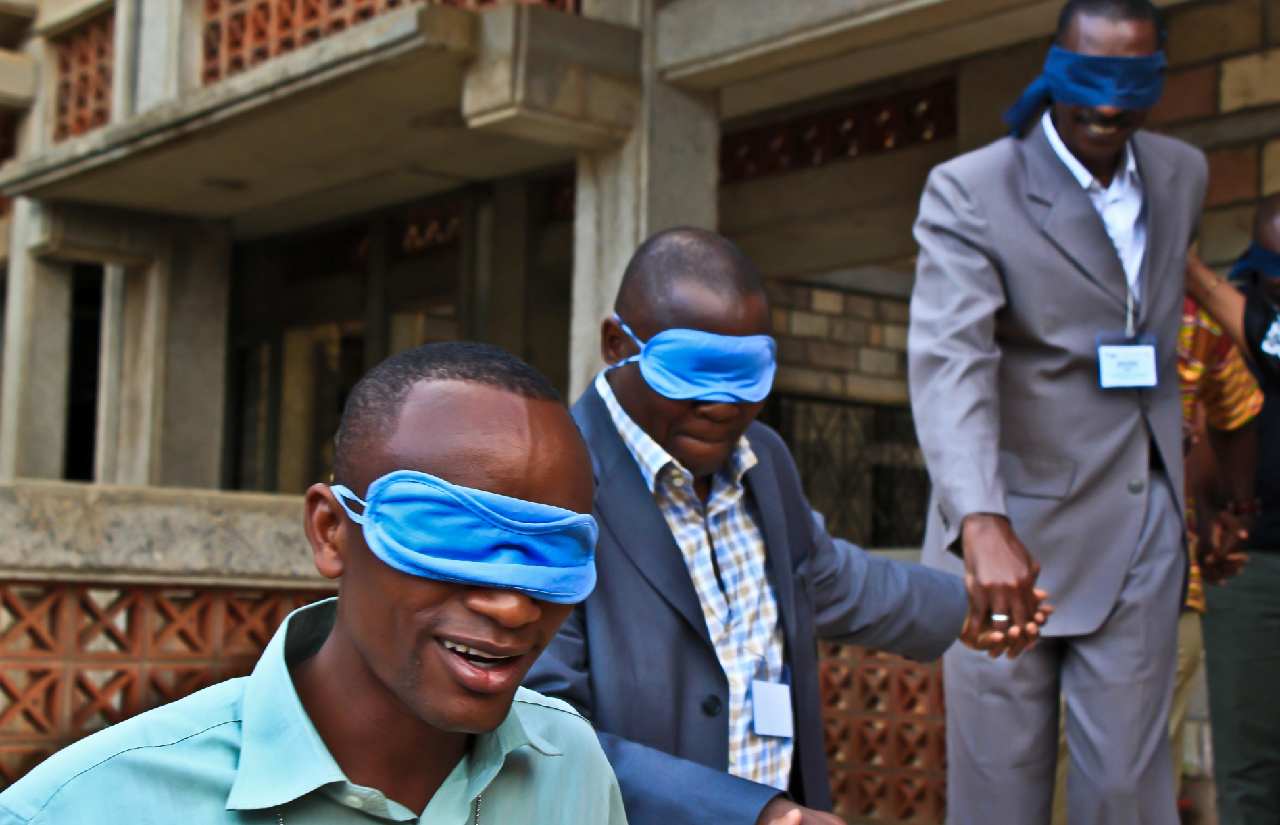
Water and Climate Change: What don’t we know?
Climate models are unable to tell us with confidence how climate change will alter the:
  Seasonality/timing of precipitation
  Amount of mean precipitation on a monthly/annual basis
  Form of precipitation
  Rate of evaporation and sublimination
  Runoff rates
  Intensity of precipitation

Slide 25
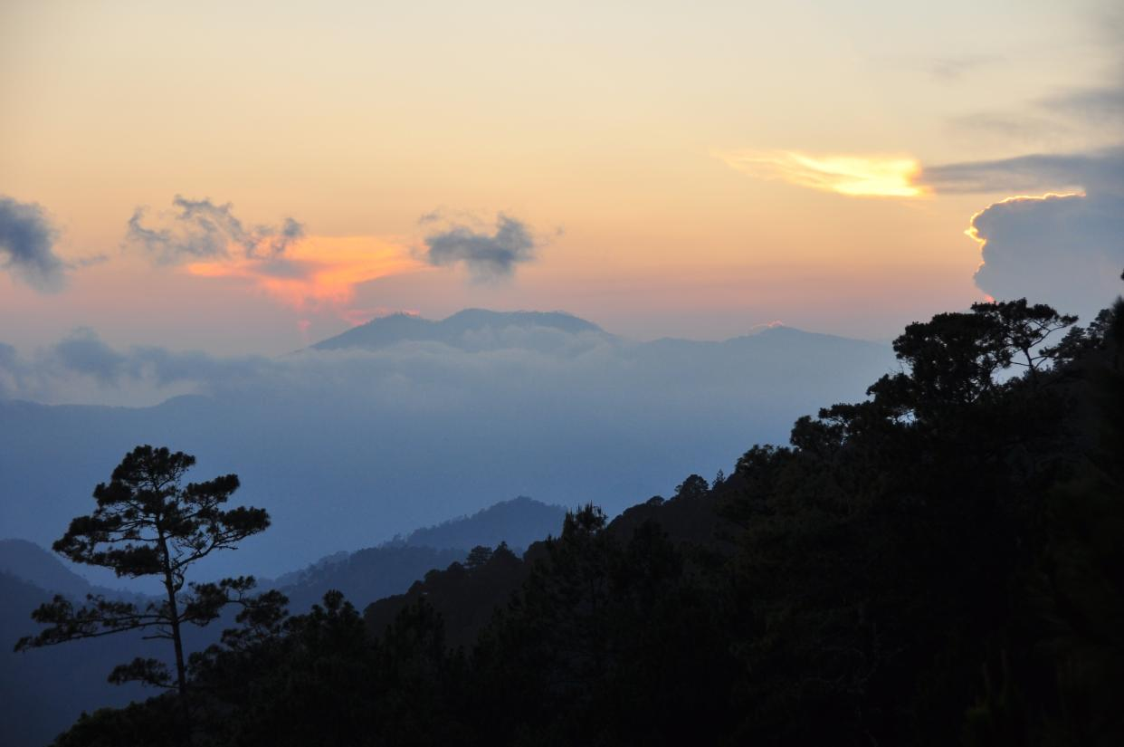
Water and Climate Change: What do we know?
Trends have important implications for infrastructure.
  Climate is growing more variable
  Increase in severe events
  Timing of precipitation is changing even when the annual amount of precipitation does not.

Slide 26
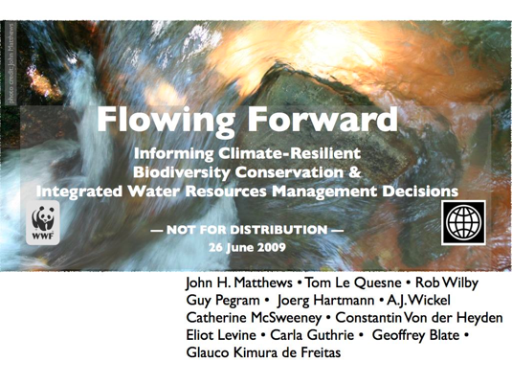
Working with Multiple Future Scenarios
A variety of methodologies for incorporating scenarios.
Flowing Forward by Le Quesne et al.
  Relatively quick process
  Inclusive of other perspectives and sectors
  Focused on a specific region/place and the interaction with climate change, biodiversity, and infrastructure.

Slide 27
Flowing Forward Methodology: The Basic Steps
1. Pre-Workshop Report
Identify Stakeholder, institutions, regulations, and sectors for the target project
Synthesize existing research
Two development pathways
2. Scenario Development
Analysis of trends
Ranking risks
Two climate change pathways
e.g. Business-as-usual, Smarter Growth
Wetter Future, Dryer Future

Slide 28
Flowing Forward Methodology: The Basic Steps
3. Key Ecosystem Elements/Drivers
Identify key ecosystem elements
Compile results of steps 1-3 into a final pre-workshop report.
4. Compile Results
Species, services, etc..
Habitat category
Identify drivers of the elements.

Slide 29
Flowing Forward Methodology: The Basic Steps
5. Identify Stakeholders and topical Experts
Policy/legal experts
Two approaches:
6. The Workshop
Key basin institutions
Hydrologists
Rural populations
Ecologists
Anthropologists
Resource managers
Finance representatives
Etc…
Top-down Analysis:
Bottom-up Analysis:
How will impacts and trends alter development, and resource management.
Alteration of natural resource consumption, biodiversity, and sustainable use in the basin
Where are the gaps?
Can they be filled?

Slide 30
Flowing Forward Methodology: The Basic Steps
7. Reconciliation
9. Update/Revise
8. Adaptation Plans Developed
Two analyses are reconciled
Plans may span:
List of risks, needs/capacities, and impacts
Institutional interventions
Policy work
Transboundary management
Monitoring/evaluation networks
Integration of technical analyses that target specific questions from the workshop
Pre-workshop report is updated and revised

Slide 31
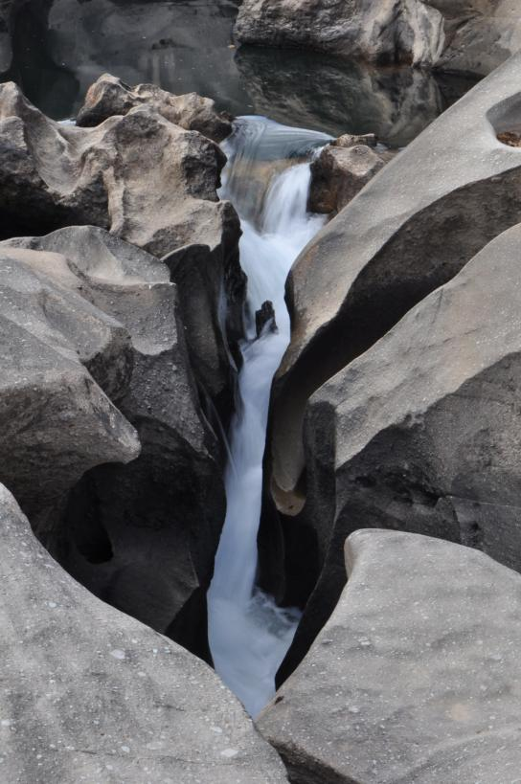
Key Lessons and principles
General Principles:
Adaptation is largely about changing the way we interact with, manage, and think about different aspects of the environment and the services they provide.
Much of our interaction with the environment is through infrastructure and the institutions that manage it. As such infrastructure presents us with opportunities to adapt.
Infrastructure:
Robust to multiple climate Futures
Resilient to extreme events
Adjustable to change
Avoid degradation
Integrate ecosystems
Institutions:
Detect change
Adjust to accommodate those changes
Learn from mistakes

Slide 32
Training Course on Ecosystem Based Climate Change Adaptation
Colofon side
This lecture has been prepared as part of the training materials on wetlands and climate change adaptation
Copyright/creative commons copyright
This material may be used for non-commercial purposes, provided that the source is mentioned. Reference to this material can be made as [Name lead developer] et al, [Title module x], Training Kit on Wetlands and Climate Change Adaptation, 2010, [web-reference]

